Slide 1
My home, my castle.
1.What is your name?
2.Where are you from?
3.What is your nationality?
4.What is your friend nationality?
5.Have you got a collection?
1.My name is…
2.I’m from…
3.I’m … ?
4.He’s…
5. I have got….

Slide 2
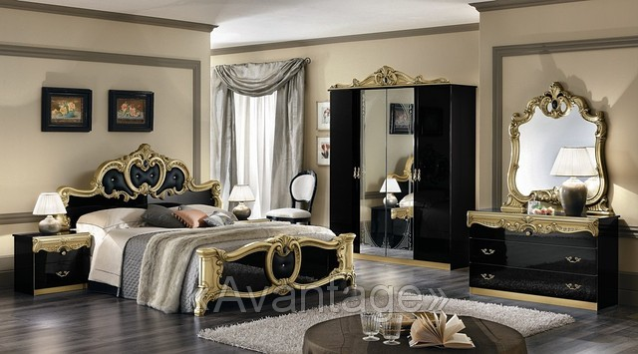
What is it ?
It is a bedroom.

Slide 3
What is it ?
It is a hall.

Slide 4
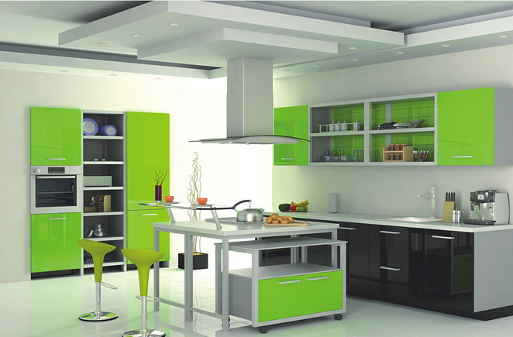
What is it ?
It is a kitchen.

Slide 5
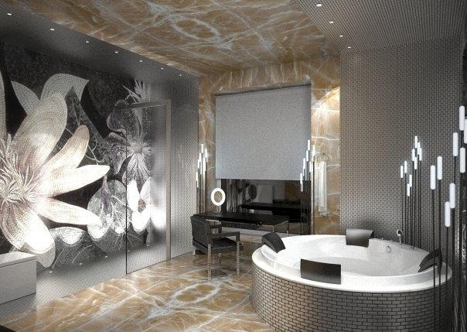
What is it ?
It is a bathroom.

Slide 6
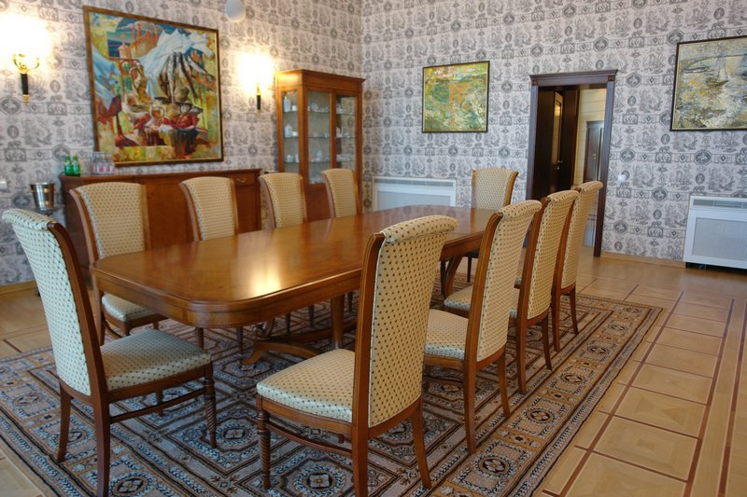
What is it ?
It is a dining-room.

Slide 7
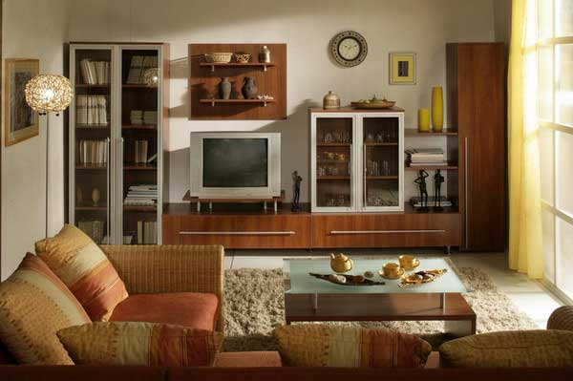
What is it ?
It is a living-room.

Slide 8
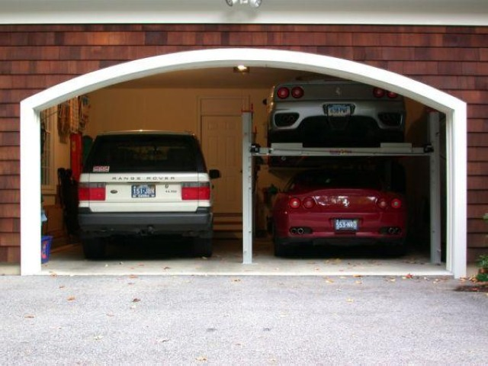
What is it ?
It is a garage.

Slide 9
th
[Ɵ]
[ð]
Sixth, seventh, eighth
Ninth, tenth, three
The, this, those, there

Slide 10
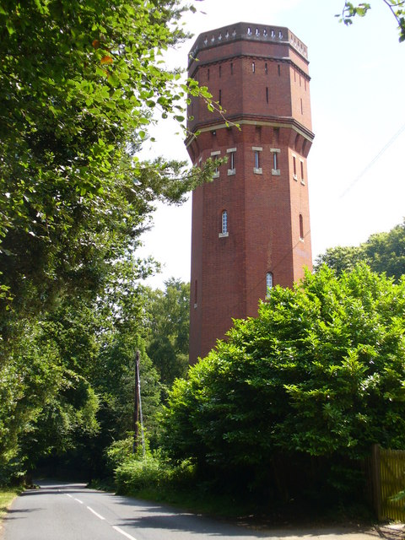
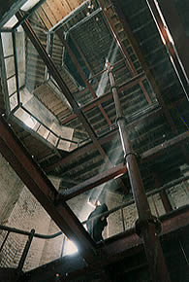
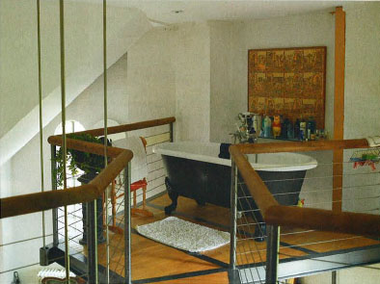

Slide 11
Live high up!
Surrey
1. There is a water tower in …
2. It is … years old.
3. The tower has got … floors.
4. There are … steps to the roof.
5. There is no …
6. There are … rooms.
7. There is a reception room on the ground floor
100
6
142
lift
9

Slide 12
My house
1. I live in a big house.
2. It is in Penza.
3. There are 2 rooms. There is a kitchen, a living-room, a bedroom in my house.
4. My favourite room is a living-room. I read books and watch TV there.
5. My house is very cosy. (уютный)

Slide 13
Thank you!

