Slide 1
Jeopardy!

Slide 2
US History | Geography | Sports | Science
100 | 100 | 100 | 100
200 | 200 | 200 | 200
300 | 300 | 300 | 300
400 | 400 | 400 | 400
500 | 500 | 500 | 500

Slide 3

US History - 100
The United States originally had this many colonies.
What is 13?

Slide 4
US History - 200
This war was fought between 1861 and 1865.
What is the American Civil War?

Slide 5
US History - 300
This Maldivian hero is famous for defeating the Portuguese in 1573.
Who is Al-Sultan Ghazi Muhammad Bodu Thakurufaanu?

Slide 6
US History - 400
He was the only president to serve for more than 8 years.
Who is Franklin Delano Roosevelt?

Slide 7
US History - 500
There are currently this number of justices in the US Supreme Court.
What is 9?

Slide 8

Geography – 100
This is the most populated country in the world.
What is China?

Slide 9
Geography - 200
These two oceans are linked by the Panama Canal.
What are the Pacific and Atlantic?

Slide 10
Geography - 300
This is the biggest state in the USA.
What is Alaska?

Slide 11
Geography - 400
This continent has the most countries in it.
What is Africa?

Slide 12
Geography - 500
This is the country where Mt. Everest is found.
What is Nepal?

Slide 13
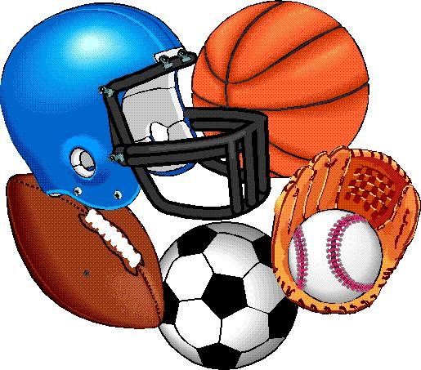
Sports - 100
Wimbledon hosts this sport.
What is Tennis?

Slide 14
Sports - 200
This city hosted the 1st Olympic Games in 1896.
What is Athens, Greece?

Slide 15
Sports - 300
In boxing KO is an abbreviation for this.
What is Knockout?

Slide 16
Sports – 400
In Snooker this is the color of the final ball potted.
What is black?

Slide 17
Sports – 500
This sport is known as the “Great American Pastime.”
What is Baseball?

Slide 18
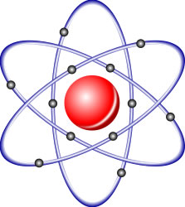
Science - 100
This instrument is used to measure temperature.
What is a thermometer?

Slide 19
Science – 200
Between gold and silver this is heavier.
What is Gold?

Slide 20
Science - 300
He wrote the theory of evolution based on natural selection.
Who is Charles Darwin?

Slide 21
Science – 400
Blood is filtered by this pair of organs.
What are the kidneys?

Slide 22
Science - 500
This vitamin is abundant in citrus fruit.
What is Vitamin C?

Slide 23
Final Jeopardy!
Write down your wagers (bets)

Slide 24

Islam
The interpretation of the word Jihad in English.
What is inner struggle?

