Slide 1
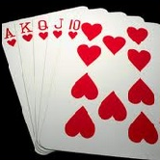
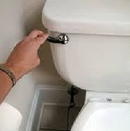


4 Pictures 1 Word
Medium/Difficult

Slide 2
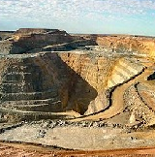
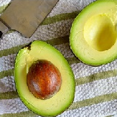
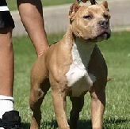

PIT

Slide 3
FLUSH

Slide 4



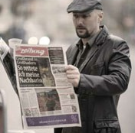
AGENT

Slide 5




JOURNAL

Slide 6
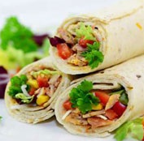
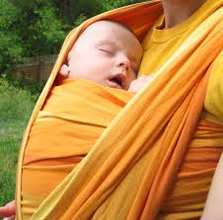
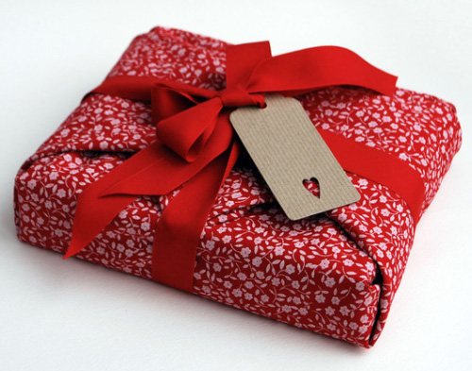

WRAP

Slide 7
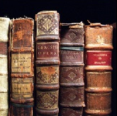
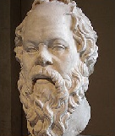
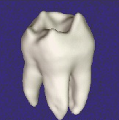
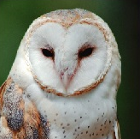
WISDOM

Slide 8

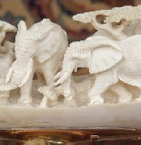
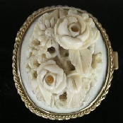
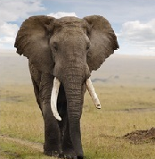
IVORY

Slide 9


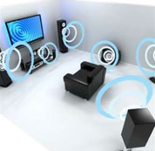
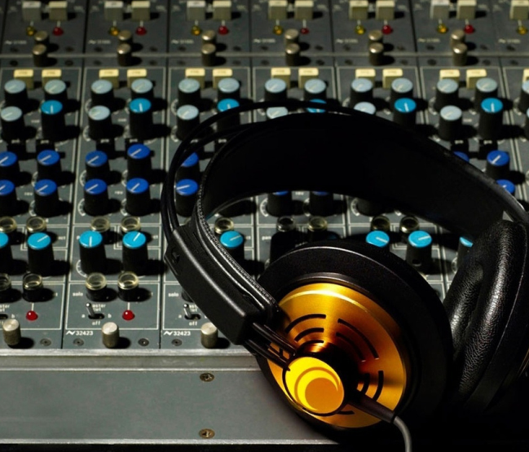
AUDIO

Slide 10
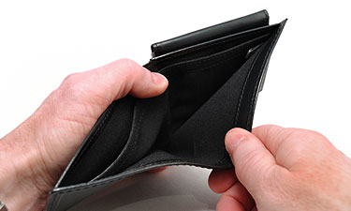


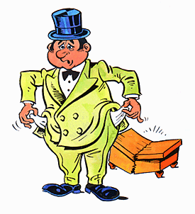
BANKRUPT

Slide 11
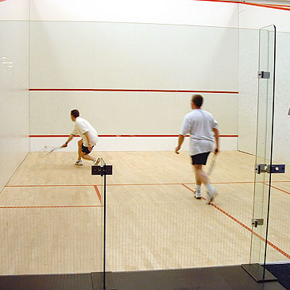
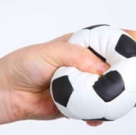
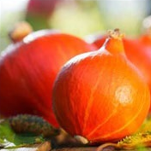
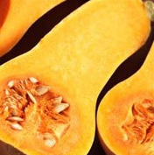
SQUASH

Slide 12
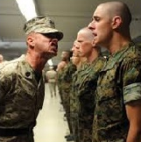
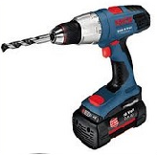
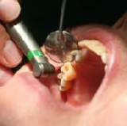
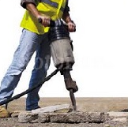
DRILL

Slide 13
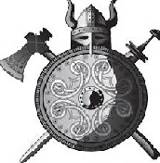
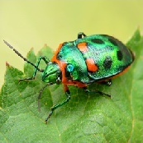
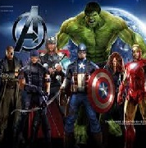
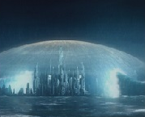
SHIELD

Slide 14
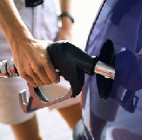
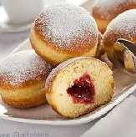
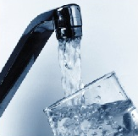
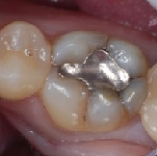
FILLING

Slide 15
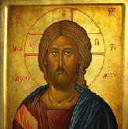
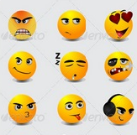


ICON

Slide 16
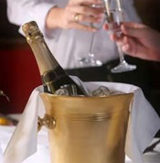



CHILL

Slide 17
PIT – armpit, pitbull, pit in fruit (avocado, peach,…), Super Pit Gold Mine
FLUSH – flushing a toilet, flush in poker, flush as get red in the face
AGENT – a spy, a kind of police officer
JOURNAL – a diary, a blog, a scientific magazine
WRAP – tortilla wrap, woven wrap for babies, gift wrap / packaging, to wrap/cover
WISDOM – wisdom tooth, owl as a symbol of wisdom, the bust of Socrates – it is thought he was wise, books as a source of wisdom
IVORY – a colour, the material elephant´s tusks are made of, ivory jewels and statues
AUDIO – sound, sound system
BANKRUPT – without any money
SQUASH – butternut squash/pumpkin, squeeze, kind of sport
DRILL – army drill, drilling a tooth at the dentist, a machine for drilling
SHIELD – a part of equipment for knights, protection, S.H.I.E.L.D – organization in Avengers movie, the hard part of a beetle
FILLING – tooth filling, donut filling, filling a car tank, to make a glass full
ICON – fashion icon, religious icon, icon on a computer screen, emoticon
CHILL – cold, to relax

